Slide 1

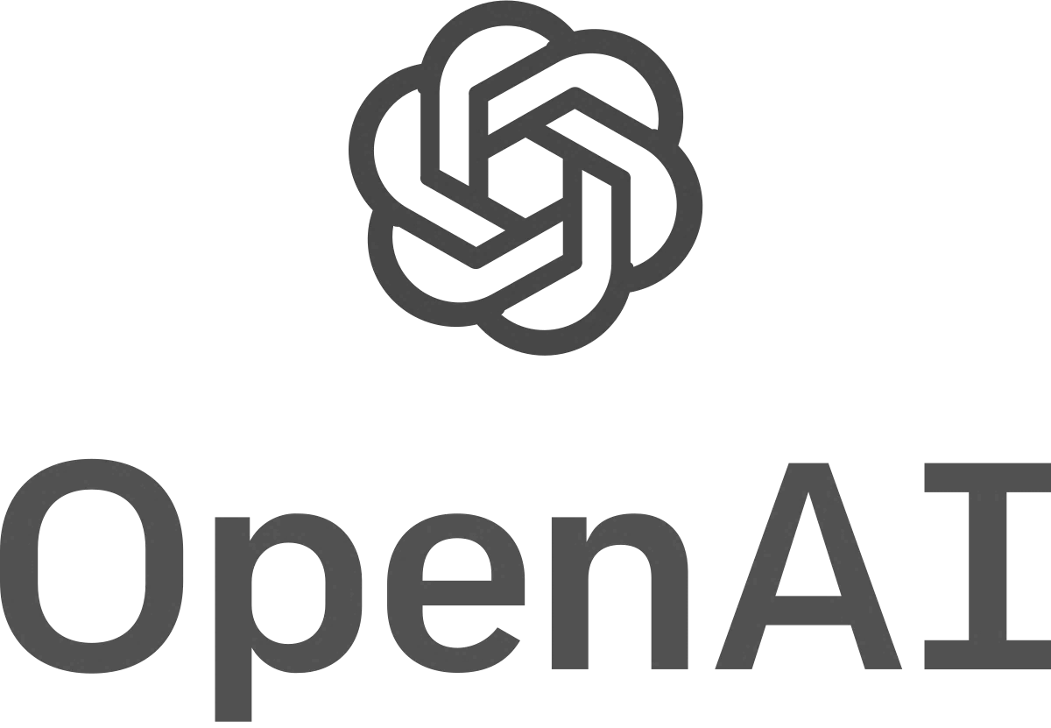
Supercharge your Data with Azure AI Search and Azure OpenAI
Pete Gallagher
Petecodes.co.uk
Notes:
HI, and welcome to this talk on how we can Supercharge our data using Azure AI Search (up until recently Azure Cognitive Search) and OpenAI.
We’ll be running through a few different topics around AI Search and OpenAI, including how these two services work, along with some theory around things like Vectors and Embeddings in the ML space.

Slide 2


About Me
Pete Gallagher @pete_codes
www.PeteCodes.co.uk
pete@pjgcreations.co.uk
Full Stack Development Manager at Avanade UK
Microsoft Certified Trainer & Azure & IoT MVP, Pluralsight Author
Decades of Desktop, Web & Embedded Software experience,
Meetup Organiser and Podcaster,
STEM Ambassador, Gadget Addict
Father of two inquisitive girls
Notes:
So… A little about me before we get going.
My name is Pete Gallagher and I’m a Full Stack Development Manager at Avanade UK.
I’m also a Microsoft Certified Trainer, an Azure and IoT MVP and a Pluralsight Author.
I’ve been in and around software for decades now, as my hair will tell you.
I also organise a few meetup groups as well as appear on a podcast.
I’m also a STEM ambassador and a recovering gadget addict.
Finally I’m father to two inquisitive girls who drive me to get out and speak about things like this.
Actually, before we get going, let’s try something shall we?

Slide 3
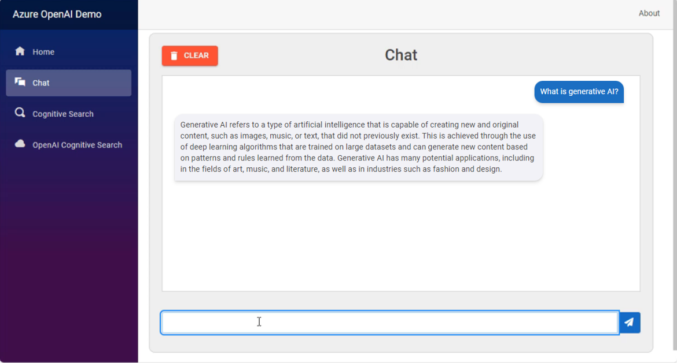

Generative Artificial Intelligence
Notes:
Ok, so, what is Generative AI?
Let’s get an autobiography from OpenAI shall we… Don’t worry… No Clippy this time.

Slide 4
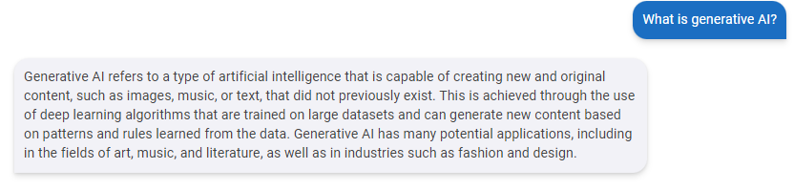



Generative Artificial Intelligence
Notes:
Ok, so the most important line for this talk is that Deep Learning Algorithms are trained on Large Datasets and can generate new content based on patterns and rules learned from the data.
As this line says, Generative AI Models are based on large sets of training data, mostly the public internet such as Stack Overflow, Github, Twitter, Reddit, 4chan… Errrr… OK… You get the idea…., Either way, they can generate content based on a set of rules and patterns it infers from that data.
In essence, these models are really good at predicting the next Token is (a word or set of words), over and over again until some content is produced.
Of course… Again, these models are essentially limited to the data they are trained on.

Slide 5
Generative Artificial Intelligence
Large Language Models
AI, Chatbots, Natural Language Understanding
Google PaLM / Bard, Meta LLaMA, X Grok, OpenAI ChatGPT
GPT 3.5 Turbo/4, Ada Embeddings, DALL-E, Whisper
Notes:
So, for the purposes of this talk, we’ll be concentrating mainly on Large Language Models.
These tend to be used in and around AI, Chatbots, Natural Language Understanding and so on.
Of course, there’s a bandwagon with heaps of Models from a plethora of companies, like Google’s PaLM, Meta’s LLaMA, recently Twitter’s Grok and of course OpenAI’s ChatGPT.
We then have sub-divisions of these models which specialise in certain areas. For OpenAI we see GPT3.5 and 4, Ada Embeddings, DALL-E, Whisper and so on. Each performing a different function.

Slide 6
Azure OpenAI
Same Models as OpenAI ChatGPT
Security, Virtual Network, Private Link
Responsible AI
Multi-Language SDK Support
Notes:
As we know, Microsoft have invested heavily in OpenAI and as such we can leverage the same Models as we have in ChatGPT directly as a service within Azure.
We can then add to those models the other offerings within Azure such as Security, Virtual Networks, Private link and so on.
Another benefit of using Azure OpenAI is that Microsoft are investing time in developing Responsible AI, allowing us to ensure that we keep a close watch on the queries from users and the associated responses from the Models, ensuring that we stay within predefined guard rails and don’t stray down paths we wouldn’t necessarily want in our solutions.
Finally, of course, we’re provided with Multi-Language SDK’s to accelerate the development process and get us to production faster.

Slide 7
OpenAI Demo
Notes:
Portal – OpenAI:
If we start out in the portal we can see the OpenAI service, some of you folks will likely have seen this, but for the folks that haven’t, it’s good to see what it looks like.
This is the landing page for the OpenAI service in the portal with the details on the right, and the standard portal menu on the left. There’s not much important to look through here to be fair, aside from the “Keys and Endpoint” page, this is the detail we need to configure our API to be able to access the OpenAI service of course. The main page of interest here is the Model Deployments page, but we can’t view our model deployments here, they’re in Azure AI Studio.
Portal – OpenAI Studio:
Switching over to that page, this is Azure OpenAI Studio, there’s actually an updated version of this site in preview, but I’ll stick to the current one.
We can see the models we’ve got deployed in the deployments tab. I’ve got a few models deployed, but we’re only really interested in the GPT4, and the text-embedding-ada models, where we’re using GPT4 for the query processing and the ada model for creating embeddings.
We can actually experiment with the GPT4 model right here in the portal using the playground.
Where we can see we have several panes here for configuration, with our chat interface in the middle.
We can query the model here, for instance, let’s ask; “What was Microsoft’s revenue in 2020?”, and we get an answer.
Blazor App - Intro:
Now we’ve seen how this works in the portal, let’s have a look at the Blazor app that we’ll be using.
This is all open source by the way, at least as far as the app is concerned, and I’ll give you a link to the GitHub repo at the end.
Here we’ve got a basic landing page describing the various sections, where we’ve got a simple chat page, an AI Search Page and finally the OpenAI AI Search Page.
Blazor App – Chat:
If we click into the Chat page, we can see we’ve got the standard query box at the bottom, the Chat Conversation window in the middle, and the Clear Chat Button… Nothing out of the ordinary here.
We can ask questions like; “What is Microsoft’s Mission”, and we get a response.
You can see that we get that nice streaming response courtesy of the SignalR connection we’re using here. This, by the way, means that we can keep all the business logic in the API layer, rather than having it in the front end, for a nice separation of concerns.
As this is just a standard chat window, we can ask what we want here, even ask for code snippets by the way like; “Write me a simply html page”, where you can see our snippet is separated from the content and we have a copy button and so on… So just as a demo of a chat app, this is relatively useful… ok, no syntax highlighting… Ha.
Given that this is just a simple chat, it’s not basing its answers on our own content. We’re going to be talking a lot about my secret company XYZ Retail in these demos… So, let’s see what OpenAI knows about them, we can ask “Tell me about XYZ Retail”… We can see that OpenAI tells us that it doesn’t have that information, which is good as this is supposed to be my little secret and I don’t want the world finding out yet.
Visual Studio – OpenAIChat.razor
Let’s switch over to our code and have a quick look at how this is working within our app. I’m not going to deep dive into the code base here, it’s all open source, you’ll be able to have a browse around for yourself, but I do want to highlight some key elements and how they’re implemented.
If we start in the Basic OpenAI Chat page here. For reference, I’m using a package called MudBlazor, which is an awesome library of UI tooling for Blazor, well worth checking out. Another point is, this is all .NET 8 too.
This page is relatively straightforward as we saw, with mainly two areas, one for the OpenAI responses and one for our query.
As far as the code is concerned, we have our SignalR hubconnection.on code, which receives the calls from the Hub, the ReceiveMessageToken call receives each section or token of the OpenAI response from the Backend API and fills in the relevant chat message with each token as it’s received.
Then we have some code that sends the query to the backend API, again via SignalR, and finally the handler to clear our chatMessages. And that’s it here…
Visual Studio – OpenAIHelper.cs
The rest of the logic is on the API side in the OpenAIHelper.cs file. There’s quite a lot in this file, and I’ll be coming back to this file a few times, but for now, let’s take a look at how we’re querying OpenAI for this simple chat page.
We have the QueryOpenAIWithPrompt function here.
Again, we know this is using SignalR to deliver the returned tokens to the frontend.
The OpenAI elements begin here on line 50 onwards, where we can see we’re creating some Chat Completion Options, which are a combination of the configuration panes we saw in the portal.
The first thing we’re doing here is creating some Messages. We can see were making use to two of the types of message here ; System and User, there’s also assistant which we’ll see in a sec.
For the System Message, we’re just asking the AI to be a Helpful Assistant, and then passing in the user query to the User messaged…
We then configure the temperature, MaxTokens and so on. Not very unusual at the moment, but this shows where we’re feeding in the information to and configuring the model.
Next up, we add in the previous messages, where the AI responses are created as Assistant messages, and the user queries as a User Type.
We then add our messages to the Chat Options and use these options to get a Chat Completion from the OpenAI Service.
Then we sit in a loop and receive each of the message tokens as they arrive.
I’m actually using a queue here to process and forward the tokens to the FrontEnd via SignalR… This just smooths out the bumpiness of the response and makes the experience look better to the user.
The Queue Processing code is right at the bottom of this file, where we can see that we grab the latest processed token and send it via SignalR.
And that’s just about it for the basic chat function. It’s a good idea for you to understand how these basic elements work together so we can build on these concepts for the full solution.

Slide 8

A World of Unstructured Data
Text, Images, Video, Audio etc
AI Model Training
Powerful Prediction Engines
Our Own Data
Notes:
We live in a world of unstructured data in many forms, from plain text, to Images, Video and Audio.
The majority of models we use are trained against data from many sources, often across the content of the public internet.
This ensures that these models become power prediction engines, able to reason over queries and provide responses which aim to answer questions.
But, we saw that they are training on the data available, which may not include our own data, so how can we work around that?

Slide 9

Retrieval-Augmented Generation
Bring Your Own Data to LLMs
Query Based on User Query
Combine Query Results with AI Prompt
LLM Response Based On Data and Prompt
Notes:
One of the options we have, and the pattern we’re going to be putting into practise here, is called Retrieval Augmentation Generation, or RAG.
This pattern allows us to bring our own data to Large Language models.
We can query that data based on the same user query we’d apply to the LLM.
We then combine the results , of that query with a suitable LLM Prompt instructing the LLM to use the data in a way which suits our application.
Then, using the power of the LLM, it can produce a far more targeted response that it would’ve been capable of previously.

Slide 10

More OpenAI
Notes:
Azure Portal – OpenAI:
Let’s switch back to the portal and to our OpenAI Playground…
So, we previously asked “Tell me about XYZ Retail” again, and OpenAI can’t give us an answer.
Well, we can see we have a few panes here. On the right we have the Configuration Pane, with some basic config settings for which models we use and how many past messages to include.
On the Parameters tab, we can configure how our model operates with parameters like the Maximum Response, the Temperature, which defines how colourful and different each answer is and so on,
We also have the Assistant Setup pane. This is where we can define how the chat bot behaves and interacts with us. This is defined by the System Message, which we saw in the chat code earlier too. We can of course choose an example from the list, but where’s the fun in that.
We could ask it to speak like a pirate for instance. Let’s see what it knows about .NET Notts shall we. love the pirate language.
Well, this system message is where we can start the process of feeding in our own data. We know that it doesn’t know anything about XYZ Retail at the moment. Well, I had OpenAI generate some accounts for XYZ retail. We can add these to our system message.
First let’s tell the system to use the data below; “Use the following information to help you answer questions;”. If we open up the 2021 accounts for XYZ and copy & paste the whole of this document into the system message. We can clear the chat, and ask our question again; “Tell me about XYZ Retail”.
We can see that we now get a decent response back from OpenAI about our fictional company.
So, this system message is where we’ll be adding context to our interactions with OpenAI.
We do have an option here, in preview of course, to bring our own data, and actually this will get us some of the way to a solution, allowing us to couple storage and Azure AI Search too, but it’s missing a few key features that we’ll come to later.
Ok… So, we know we need sort out adding our own data to this process.
So, let’s switch back to the slides as I want to cover a couple of concepts.

Slide 11

More “RAG”
Ingest Data
Break into Small Parts
Store in a Database
Retrieve using Queries
Notes:
OK, so, I wanted to talk a bit more about Retrieval Augmented Generation and introduce some concepts.
The way we are going to operate, is to upload our data and process it.
One of the main things we’ll do is break our data into smaller parts which will make that data easier to digest for AI models. This technique is called Chunking, and there are various methods we can use from a page by page down to a paragraph by paragraph approach.
Then, for each of these chunks, we store them in a Database, along with some metadata about that chunk.
This then allows us to query across all the data and retrieve the relevant parts based on a query.

Slide 12
Azure AI Search - Overview
Cloud Search
Query Your Data
Query via Text, Fuzzy, Auto-Complete, Vector
Multi-Language SDK Support
Notes:
So, let’s talk a little about the database element of our solution, Azure AI Search.
Azure AI Search up until recently called Cognitive Search, is an offering from Microsoft giving us a full search service in Azure.
It allows us to index and Query over data stored in the database.
We offered a set of different ways to query, including via Text, Fuzzy-Matching, Auto-Complete and importantly as you’ll see, Vector Search.
Of course, as with most Azure services, we kindly provided with a fully featured set of SDKs for just about any language we need.

Slide 13
Azure AI Search - Indexes
Indexes
Schemas and Fields
Filters and Facets
Queries
Notes:
A few more concepts we should know for Azure AI search.
We store our data in an Index, which is akin to a table in a regular database.
Indexes have a schema comprising fields, definitions and attributes… Indexes, of course, are where we then store our documents.
Within the Fields we can set attributes which define how that field operates. One notable attribute allows us to set whether we can Filter on that field.
A second notable attribute is Facetable which allows us to retrieve a list of options for that particular field which we can use for filtering.
Finally, we have Queries., obviously super important for a Search Service.

Slide 14
Azure AI Search - Queries
Full-Text Search
Vector Search
Hybrid Search
Semantic Search
Notes:
We have several options for querying which I briefly mentioned on the previous slide.
The most basic Query we have is Full Text Search, which allows us to do an almost CTRL+F search through our content, and specifically the fields that are marked as Searchable. Full-Text search can be used for simple searches, or perhaps filling auto-complete or auto-suggest fields in the UI.
Next up we have Vector Search, which is the type of search which underpins our content in this application. We’ll talk more about Vectors shortly, but simply put Vectors are numerical representations of our content, and Vector Search allows us to compare these numerical representations to return a scored results.
We can then combine these two types of searches into a Hybrid Search, which helps us to further refine the results we get from our Queries.
Finally, we can add in a Semantic Search. This type of search is actually a re-ranking system, where the initial results are passed through a semantic re-ranker and produces an even more refined results in relation to the ordering and scoring of the results.
Semantic search examines the semantic meaning of surrounding words and phrases to a match and elevates those results higher in the result set.
It’s worth noting that Semantic Search is, depending on the tier you choose, a chargeable service.

Slide 15
AI Search Demo
Notes:
Ok, so… let’s take a quick look at Azure AI Search…
Azure Portal - AI Search:
If we switch back to the portal now, we can have a look at what the Azure AI Search service looks like.
This is the landing page for the AI Search Service with the main details on the right and the portal menu on the left.
The main blade to show you in the Search Service from the point of view of this application is the Indexes Page.. I mentioned in the slides earlier that the index is where we store our data in whatever form we decide to use. For us, we’re storing our document chunks here in the openai-demo index.
I’ve already created an index and uploaded the same PDF we saw earlier to it.
Azure Portal - AI Search – Search Explorer:
Clicking into our index we’re shown the Search Explorer, which allows us to search our index using a query language.
Here we can do a full text search through our index… For instance we could search for; “new retail locations”, which brings us back some results.
We have access to a powerful query language here which I’m not going to dive too deep into, but if we switch to the JSON view here, we can select which fields are returned by adding a “select” property, and a comma separated list of fields to return; "select": "content,year", which returns us just the content and year fields.
Azure Portal - AI Search – Fields:
Switching to the fields tab, here we can see the various fields, essentially columns, that our index has; id, title, content and so on.
Next to each of our field names are a columns of tick boxes. These allow us to select which of the fields can be retrieved, filtered, sorted, faceted.
At the bottom of the list of fields, we can see two different fields… These are something called Vector Fields, which the eagle eyed amongst you may have seen on the previous screen… We’ll have a chat about what Vectors and Vector Embeddings are shortly.
Azure Portal – AI Search – Other Tabs:
The other tabs we have here are CORS, for ensuring we allow or limit access to the search service.
The Scoring Profiles tab allows us to create profiles which define a criteria to boost the search score of non-vector searches.
The contents of the Semantic configurations and Vector Profiles tabs we’ll cover a little later on, but these relate to how the semantic re-ranker works over our data and how vectors are stored and retrieved, where you can see that we already have one of each defined here.

Slide 16
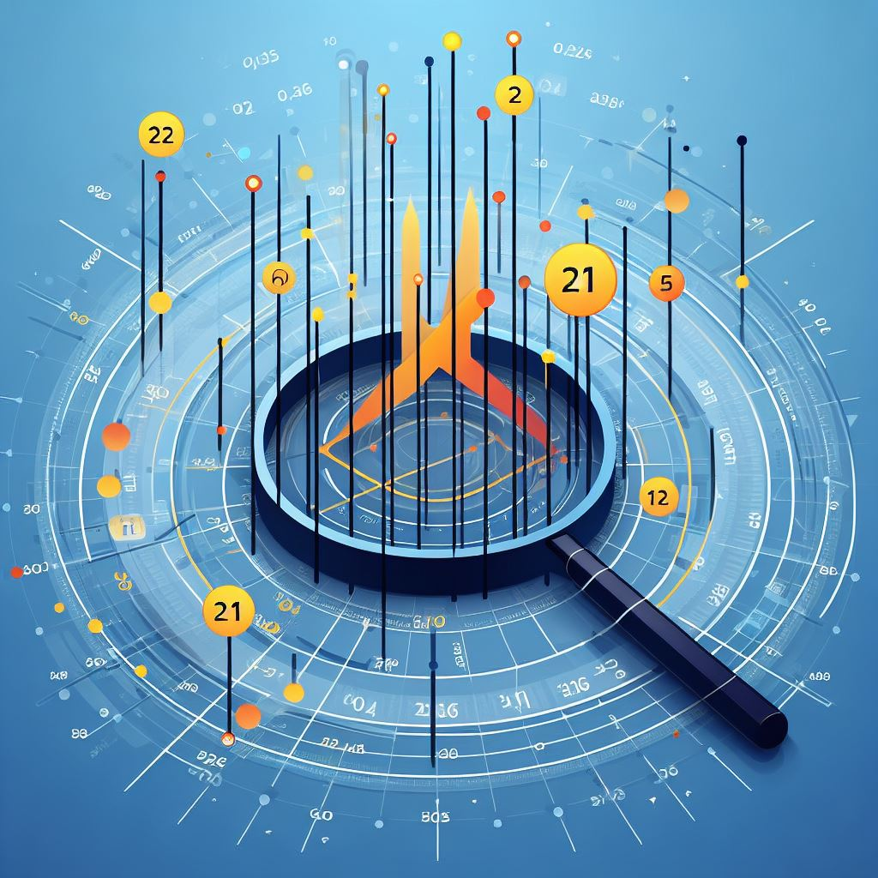
Vector Embeddings
Convert unstructured data to numbers
Created using AI Embedding Models
Vector Database
Compare two sets of Vectors
Notes:
One of the other steps in processing our data will be to use something called Vector Embeddings.
We know we need a way to combine our data with the model, but we also need a way to retrieve our own data from a database with a Query.
Vector Embeddings are a way to convert unstructured data into a numerical representation of the meaning and intent of a word, phrase, paragraph or indeed, image, video or sound that can be interpreted by an AI Model.
We create these Embeddings using specific Embedding AI Models, which are specifically trained to produce the vectorised output that we use for our scenario, and which capture the semantic meaning of the word or phrase rather than it just being a keyword.
Of course, one of the use cases we’ll have seen this before on sites like Amazon, Netflix and Spotify is within recommendation engines, where these system can help us find other items which closely match the things we’re looking at, or our shopping, watching or listening habits.
We can store these vectors in specific Vector Databases which are designed for storing and retrieving large amounts of vectorised data using Indexes. Some examples of these are Qdrant, Faiss, Weaviate and of course Azure AI Search.
Once we’ve created and stored our vectors, we can then query over the data and essentially compare sets of vectors. This works by performing a numerical analysis of vectors, calculating a numerical distance between vectors using something called cosign similarity.

Slide 17
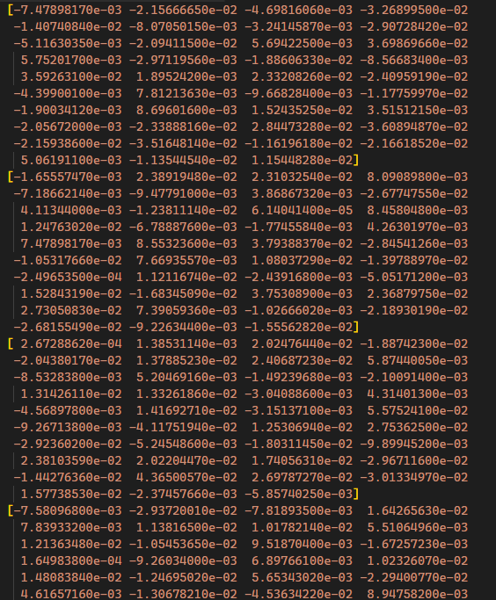
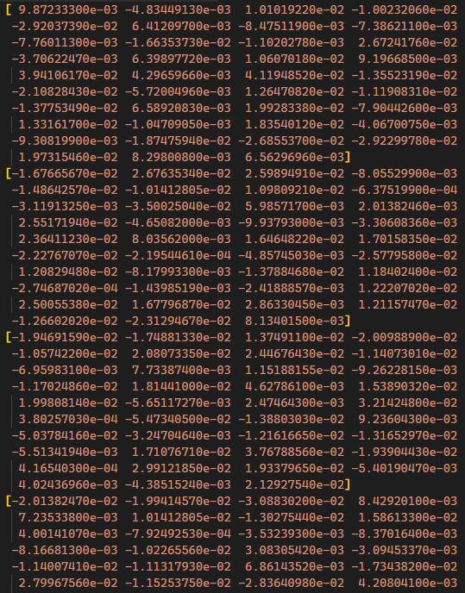
Vector Embeddings
Car
Lorry
Notes:
So, let’s have a look at what Vectors look like, and specifically word embeddings here.
On the left we have the top half of the vector embedding for the word Car.
On the right we have the corresponding vector for the word Lorry.

Slide 18
Vector Embeddings
Notes:
Querying over vectors essentially allows us to perform a numerical comparison of the various facets of these two words, calculating a distance between the two words
Vectors help us to word around the traditional limitation of a keyword-based search by actually allowing us to capture the meaning of words and phrases in context.
So we can capture the similarity, or indeed difference, between two words.
A good way of thinking about this is, if we were looking for a similar word to Cat, it would be easy to run your finger along a list of words and say that the word Car was similari to cat, as there’s only 1 letter difference.
By using vectors, we can capture the nature of the vector and find perhaps dog rather than car.

Slide 19



Embeddings and Vectors
King
Man
Woman
Queen
Notes:
One rather well known example of what vectors allow us two do is the king queen example.
If we image the vector for a king.
Using vectors, we can grab the vector for a man….
and subtract it from King.
We can then add the vector for a woman, and hey presto, we get a Queen.

Slide 20
Vector Embeddings
King
Woman
Notes:
Looking at that again, we start with a King.
Subtract man, leaving essentially the crown, add a woman….

Slide 21
Vector Embeddings
Queen
Notes:
And we end up with the vector for a queen…. Pretty powerful huh.

Slide 22
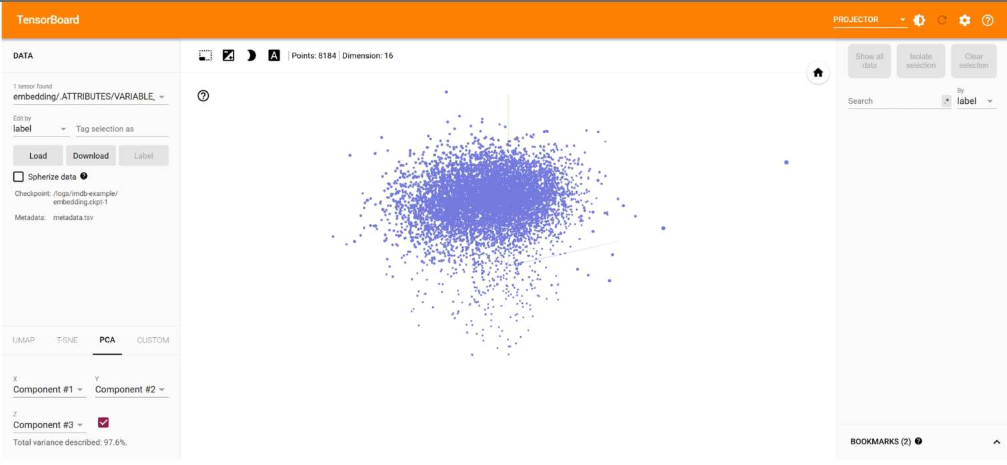
Vector Embeddings
Notes:
We can actually visualise embeddings by projecting them into a 3d space using a tool called TensorBoard, I’ll be providing a link to this at the end.
By processing a bunch of IMDB reviews using an embedding model, and storing that in a database, we can visualise the context of all of the words in those reviews and view the vector similarity distance of those words in 3d.
We can see we have words like; “found”, “build”, “powell”, “suggest”, “latter”, “moving” and so on.

Slide 23
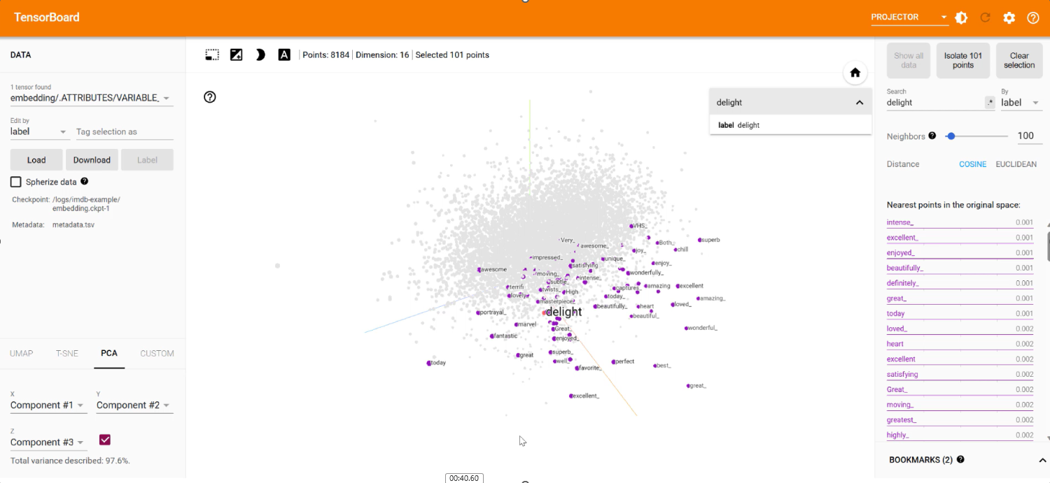
Vector Embeddings
Notes:
If we drag this around, we can then search for a particular word, say “delight”.
Selecting it, we’re shown all of the words which are numerically close in distance to delight, where we can see that they’re overwhelmingly positive words like “amazing”, “great”, “wonderful”, “perfect” and so on.

Slide 24
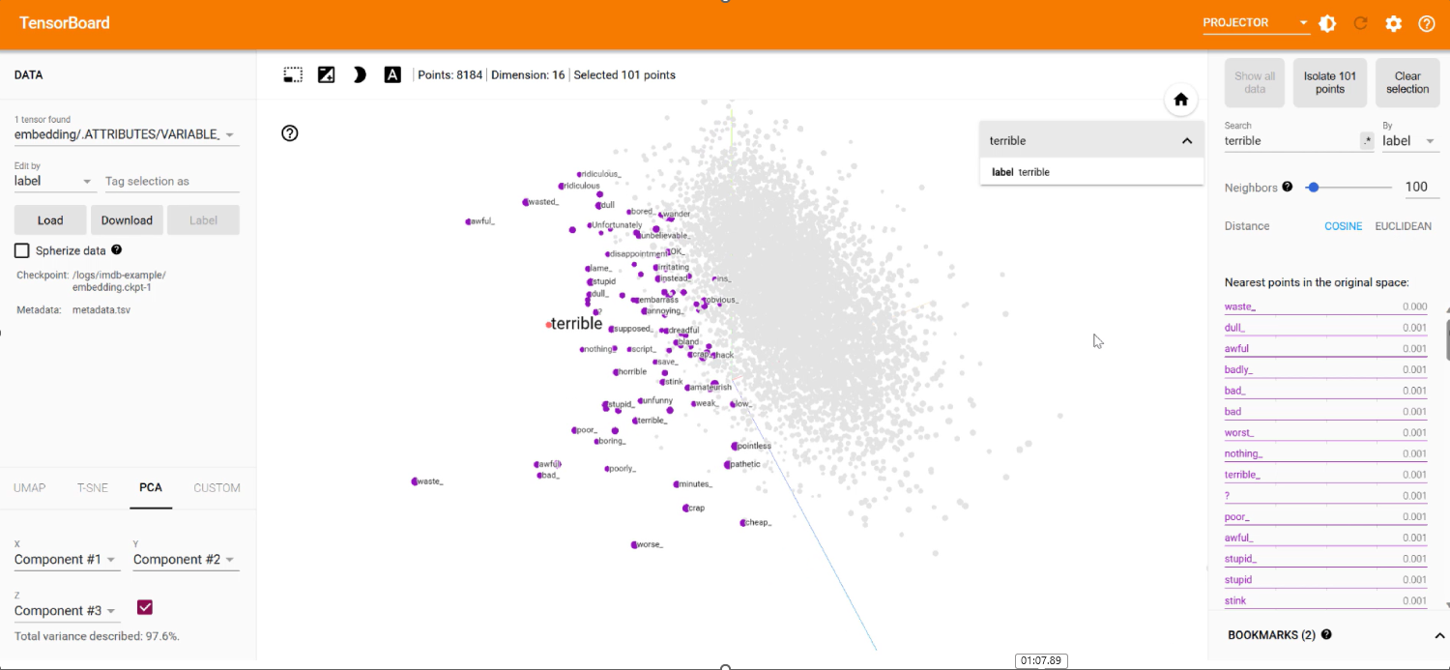
Vector Embeddings
Notes:
Dragging this around, we can then try searching for something like “terrible”.
We can see that the highlighted words have literally swapped to the other side of the projection space, and we can see words like; “horrible”, “stupid”, “boring” and “poor”.

Slide 25
More AI Search
Notes:
Blazor App – AI Search:
Ok, so now that we know a bit more about AI Search and Vectors, let’s take a look at the basic Azure AI Search in our app.
If we navigate to the AI Search Page, here we have a similar looking page to our chat page, but with an added selection for a search type which I’ll come back to.
At the bottom of the screen we have a query entry box.
I’ve already gone ahead and created an index and uploaded the set of accounts that I showed you the PDF of earlier.
So, let’s enter a query…. If we enter “What was XYZ Retail’s net income in 2021?”, we can see that we get results back from AI Search.
At the top of the screen we have a selection for the type of search we perform.
We’ve got Vector Search selected by default here, but we have a couple of other options to choose from too.
Dropping this down, we can see that we’ve got Simple Hybrid Search and Semantic Hybrid Search.
We briefly discussed these two search types earlier, where the Simple Hybrid Search searches both vectors and full text together, and the semantic hybrid search does this and adds the Semantic re-ranker into the mix too.
We don’t have enough data loaded into our index to make the difference between these options fantastically evident, but in large datasets, these search types can be very useful indeed.
Visual Studio – AISearch.razor
Right, so let’s switch back to Visual Studio and have a look how the AI Search Page works.
Skipping past the markup, as there’s not much to it here.
We can see that we start by connecting the SignalR Connection, just as we did on the chat page. For this page, I guess we could’ve just used a regular API call and response, but as the SignalR side is all there and setup, why not use it.
On this page we’re just querying for and receiving the Search Results via SignalR, where the query is sent a little first down.
Visual Studio – CognitiveSearchHelper.cs - SingleVectorSearch
Like the OpenAIHelper.cs file, we have a CognitiveSearchHelper.cs file… More leak through from the name change by the way.
There’s a fair amount in this file, but let’s concentrate just on the SingleVectorSearch on line 291 onwards for now, which is the one of the main functions for our AI Search Page.
We take in the user query and then some optional parameters, including the k (the number of search results to return) and a couple of filters for the company and year.
The first thing we do with our query is to create a Vector Embedding from it using the ada 2 model. This bit of code is directly above this function and uses the OpenAI client to generate an embedding from the query text.
Next up we set up the options for our AI Search query, where we pass in the vectorised version of our query, along with the number of results we want and the fields to query against, where we’re only querying against the contentVector field for our query.
We also then specify how many of the results we want to return back to the front end, where we can use skip functions here to return a paged response should we want.
We then specify which fields we want to return in the results.
Next up we apply any filters that have been passed in and send the Search to the Search Client.
We get an array of search document types back here, so we need to convert them to something useable for our app.
Next, we have some optional filtering code where we can perhaps only return results which match a certain score, I just return the original results for now.
Visual Studio – CognitiveSearchHelper.cs - SimpleHybridSearch
For the Hybrid Search, the only difference here really is that we also pass in the original query to the SearchAsync function on line 407.
Visual Studio – CognitiveSearchHelper.cs - SemanticHybridSearch
And finally for the Semantic Hybrid Search we need to do some setup on lines 470 onwards.
We also point it to our semantic configuration. We’ll see that later on, but we saw that in the portal too.
We can then set that we want to have the semantic search extract the passage of text it found from the query, as well as the set that we want the answer word or text to be extracted too, and finally whether we want these to be returned html highlights.
All of these can make for a nice experience for the user, as it shows where the information was located.
And that about covers our options to query the index, but how do we combine these AI Search results with OpenAI?

Slide 26



“RAG” In Detail
Notes:
As we’ve covered already. Retrieval-Augmented Generation relies on having our own corpus of data stored in a database of some sort.
With this data, we can query over it and combine the results with a user query and prompt to utilise the power of an LLM to reason over that combined data.
For the most common example, and the one we’re utilising here, we start with a User interface, which is connected to an API, which in turn connects to a database and an LLM, in our case, Cognitive Search and OpenAI.
The user then uploads one or more documents, in our case PDFs, through the User Interface and to the Backend API.
The API then splits the documents into chunks and uses an Embedding Model in the LLM to produce vector embeddings for each.
Each embedding is then stored in the database for later retrieval.

Slide 27




“RAG” In Detail
Notes:
Once this process is complete, users then start performing queries.
So, a user inputs a query through the User Interface to the Backend API.
The BackEnd API, then converts the query into a Vector Embedding using the same ada model that the chunked documents were processed with.
This embedding is then delivered to the database to query the index.
The database then returns a set of closely matching results in a text form, as well as some meta data about those results to the API.
The API then combines the original user query with the returned results along with a suitable prompt and sends that to the LLM for it to reason over.
The LLM then returns a result based on the data to the API.
The API then combines the LLM response with the database results and delivers those to the user via the User Interface.
For our application the communication between the UI and the API is all over SignalR actually. This means we can stream responses back from OpenAI through the API to the UI, keeping the front-end responsive and slick.

Slide 28
“RAG” Time
Notes:
Blazor App – Open AI + AI Search:
Ok, so now it’s time to see the app and Retrieval Augmented Generation in action.
Switching back to our App and clicking through to the OpenAI + Ai Search page.
This page has a section of the top where we can upload files, a filters section similar to the AI Search Page, and an Options section.
Below that we have the AI Response section on the left, and the returned sources from AI Search on the right.
Finally, we have the standard query box on the right.
So, let’s try the same query we’ve used before; “What was XYZ Retail’s net income in 2021?”
And we can see we have a decent response back from OpenAI. We can see that it’s cited it’s source here too.
On the right-hand side in our sources list, we can see that we have a list of sources returned from AI Search, which we’ve fed to OpenAI in order for it to use as a source of data.
We can see that the first item in the list is the reference that OpenAI has used to tell us the net turnover of XYZ at $90,000.
Of course, if we try that for 2022; “What was XYZ Retail’s net income in 2022?”
We can see we don’t get a response.
However, at the top here, we can upload new files to the index. So, let’s upload the 2022 accounts.
And we can see that the file has been uploaded and processed.
So, let’s ask the same question again; “What was XYZ Retail’s net income in 2022?”, where we can now see that we get an answer of $100,000.
For reference, we’re using a Hybrid Semantic Search on this page.
If we switch back to the Search Page… We can get a glimpse of the different types of search now that we have some more data to query against.
On this page we’ve defaulted to a Simple Vector Search…
If we perform the same query again “What was XYZ Retail’s net income in 2022?”, we can see that we get a 2021 item return as the second result.
Let’s switch to the Simple Hybrid Search and repeat the search. With that we can see that 2021 has dropped to third place now.
And now with Semantic Search… And we can see that the 2021 result is now the last result.
So, we can see the basics of how those different search options operate.
Visual Studio - OpenAIAISearch.razor:
So, returning to visual studio, we can have a look at the OpenAI + AI Search Page.
A lot of this file will look familiar, as it comprises the concepts we’ve seen on the other two pages and introduces some new concepts too of course.
We’ve got our now standard SignalR section at the top, hooking up when we both receive a message token from OpenAI, and below that, when we receive the sources back from Cognitive Search.
Then down on line 324, we send the query to the back end for it to process.
We can see we’re invoking the SendCogSearchQuery call.
Visual Studio – ChatHub.cs
All SignalR method invocations are processed through the ChatHub.cs file.
We can see on line 37, that we have our SendCogSearchQuery method. After instantiating the CognitiveSearchHelper, it calls the SemanticHybridSearch function with the query, the number of search results and the filters.
Visual Studio – CognitiveSearchHelper.cs – ComposeIndex:
Switching over our Cognitive Search Helper class.
We’ve already seen how the search side of the class works… So let’s take a look at how the various other functions work, starting with creating an index.
If we scroll down to the ComposeIndex method on line 123, here we can see how we’re creating our Azure AI Search Index.
The first thing we assign to our new Search Index, are the Vector Search Profile and Algorithm, where we create a new profile, and then assign the HNSW algorithm config to that profile.
HNSW stands for Hierarchical Navigable Small Worlds, and is one of the best algorithms for Vector Search. I’m not going to deep dive into HNSW, but it works like being zoomed out in a map to begin with, and then you start zooming in when you start to recognise something, the more you recognise, the more you zoom in.
Next we create a Semantic Search configuration specifying;
- The title field – In our case the title of the document we uploaded,
- Which fields we’ll be searching in, in our case the content field,
- Then the keyword fields which allow the re-ranker to gain more semantic meaning from the content and query.
Next up, we define the Fields for our Index… Again, these are similar to columns in a traditional database.
For each field, we set whether the field is filterable, sortable, facetable and so on.
We also create two vector fields, one of the title and one of the content, both being searchable, both with ModelDimensions, which we set to 1536 at the top of this file to match the ada model, and we assign the Vector Search profile we defined above.
And that’s it for our index.
Visual Studio – FileUploadController.cs:
Finally, we saw that we were able to upload a file earlier, let’s take a look at that process.
If we open up the FileUploadController.cs file, we can see the Upload Method, which grabs each file uploaded, extracts the contents and processes them.
Visual Studio – PDFHelper.cs:
We’re using the PDFHelper here to process the uploaded PDF into chunks. Based on a paragraph essentially, but with a minimum length of 250 and a maximum length of 7000 characters.
We’re making use of the PDFPIG nuget package to process the PDF.
I won’t dive into this file, but again, the code is open source, so take a look.
Visual Studio – CognitiveSearchHelper.cs – ProcessExtractionsAsync:
Once we have the extracted paragraphs from the PDF, we can process each using the ProcessExtractionsAsync in the CognitiveSearchHelper.cs file.
On line 236, we have the ProcessExtractionsAsync method.
Here we’re grabbing the metadata from each extracted paragraph, and then creating an embedding for the content, before adding it to a list of Search Documents to be added to the Index.
Visual Studio – CognitiveSearchHelper.cs – GenerateEmbeddings:
The embeddings are created below on line 280, where we use the OpenAI client and the ada model to create a vector embedding from the content the same way we did for a Vector Search, which makes sense.
One thing to note is, using SignalR here, really keeps the UI and UX nice and reactive, with the user being kept up to date of the progress of any processing, which I like.
Visual Studio – OpenAIHelper.cs – QueryOpenAIWithPromptAndSources:
Finally, we can see how we’re hanging all of this together for OpenAI in the OpenAIHelper.cs file.
If we scroll down to line 133 and the QueryOpenAIWithPromptAndSources method, most of this method is the same as the regular Query Method, only now we’ve got some different prompts.
The initPrompt details that the model should be an expert in supplied parts of documents, as well as returns tables and so on as html and use bullet points where relevant.
We also include the date as OpenAI thinks it’s still 2021 of course.
Next, we tell it to use facts and numbers from the sources we provide it.
Again, we could filter and order the data here before sending it to openAI, but we just combine all of the original sources together and append them to the sourcesPrompt.
We then create our ChatCompletionOptions passing in our initPrompt and Sources Prompt
Before adding in the previous conversation and sending the query to OpenAI as before.
Conclusion:
And that’s about it!

Slide 29
“RAG” Recap
Notes:
So, just to recap, The user uploads one or more documents, in our case PDFs, through the User Interface and to the Backend API.
The API then splits the documents into chunks and uses an Embedding Model in the LLM to produce vector embeddings for each.
Each embedding is then stored in the database for later retrieval.

Slide 30
“RAG” Recap
Notes:
A user then inputs a query through the User Interface and the BackEnd API then converts the query into a Vector Embedding.
This embedding is then delivered to the database to query the index.
The database then returns a set of results, which the API combines with the original user query and uses OpenAI to generate a response.
This response is sent along with the Search Results to the Front End.

Slide 31
Links
Web App Source Code https://bit.ly/pjgopenaisuperchargesource
Azure OpenAI https://bit.ly/pjgopenaiservice
Azure AI Search https://bit.ly/pjgaisearchservice
Microsoft Retrieval-Augmented Generation Overview https://bit.ly/pjgragoverview

Slide 32

Contact Me
Pete Gallagher @pete_codes
www.PeteCodes.co.uk
Pete@PJGCreations.co.uk
Slides: https://bit.ly/pjgopenaisuperchargeslides

